Slide 1


Slide 2

Introduction to
Data Science
(IT4142E)

Slide 3
Contents
Lecture 1: Overview of Data Science
Lecture 2: Data crawling and preprocessing
Lecture 3: Data cleaning and integration
Lecture 4: Exploratory data analysis
Lecture 5: Data visualization
Lecture 6: Multivariate data visualization
Lecture 7: Machine learning
Lecture 8: Big data analysis
Lecture 9: Capstone Project guidance
Lecture 10+11: Text, image, graph analysis
Lecture 12: Evaluation of analysis results

Slide 4
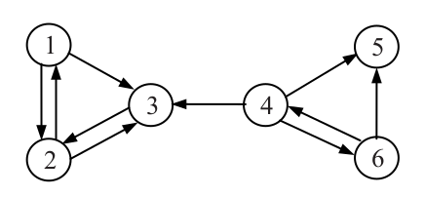
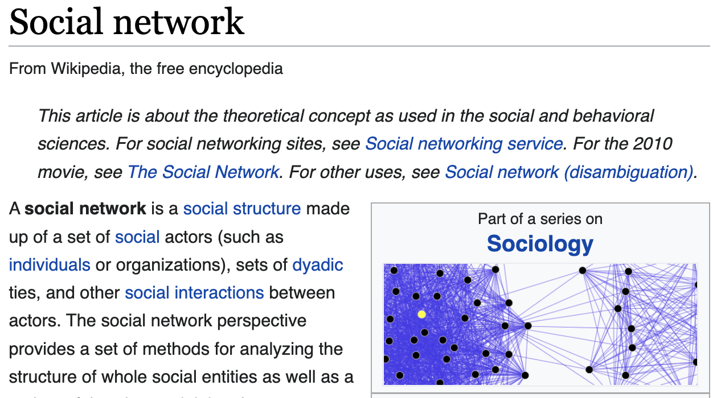
Links and hypertext
Questions
Do the links represent authority to some pages? Is this useful for ranking?
How likely is a page, pointed to by the SOICT home page, about Math?
Application areas
The Web
Email
Social networks, …

Slide 5
Links are everywhere
Powerful sources of authenticity and authority
Mail spam – which email accounts are spammers?
Host quality – which hosts are “bad”?
Phone call logs
The Good, The Bad and The Unknown
?
Good
?
?
Bad
?
(Some slides came from Chris Manning and Pandu Nayak)

Slide 6
Example: Good/Bad/Unknown
The Good, The Bad and The Unknown
Good nodes won’t point to Bad nodes
All other combinations are plausible
?
Good
?
?
Bad
?

Slide 7
Simple iterative logic
Good nodes won’t point to Bad nodes
If you point to a Bad node, you’re Bad
If a Good node points to you, you’re Good
?
Good
?
?
Bad
?

Slide 8
Simple iterative logic
Good nodes won’t point to Bad nodes
If you point to a Bad node, you’re Bad
If a Good node points to you, you’re Good
Good
?
Bad
?

Slide 9
Simple iterative logic
Good nodes won’t point to Bad nodes
If you point to a Bad node, you’re Bad
If a Good node points to you, you’re Good
Good
Bad

Slide 10
Many needs for link analysis
Community detection in social networks
Detect user groups, each contains some users with similar behaviors/interest
Shoppers’ affinity
Consumers whose friends spend a lot, spend a lot themselves
Citation analysis
Detect influential research from citation
…
Cite (refer to) other research papers

Slide 11
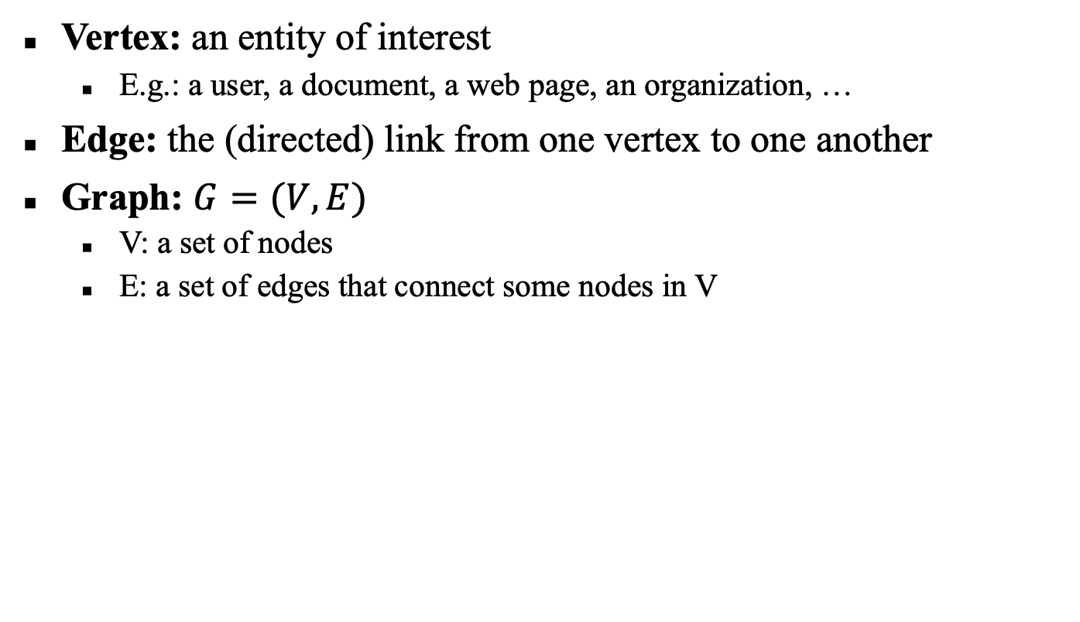
Links and graphs
Vertex: an entity of interest
E.g.: a user, a document, a web page, an organization, …
Edge: the (directed) link from one vertex to one another
Graph: $G=(V, E)$
V: a set of nodes
E: a set of edges that connect some nodes in V

Slide 12
The Web as a Directed Graph
Page A
Page B
hyperlink
Hypothesis: A hyperlink between pages denotes a conferral of authority (quality signal)

Slide 13
Popular tasks in Link Analysis
Vertex ranking
Community detection
Node classification
Link prediction

Slide 14
Centrality analysis

Slide 15
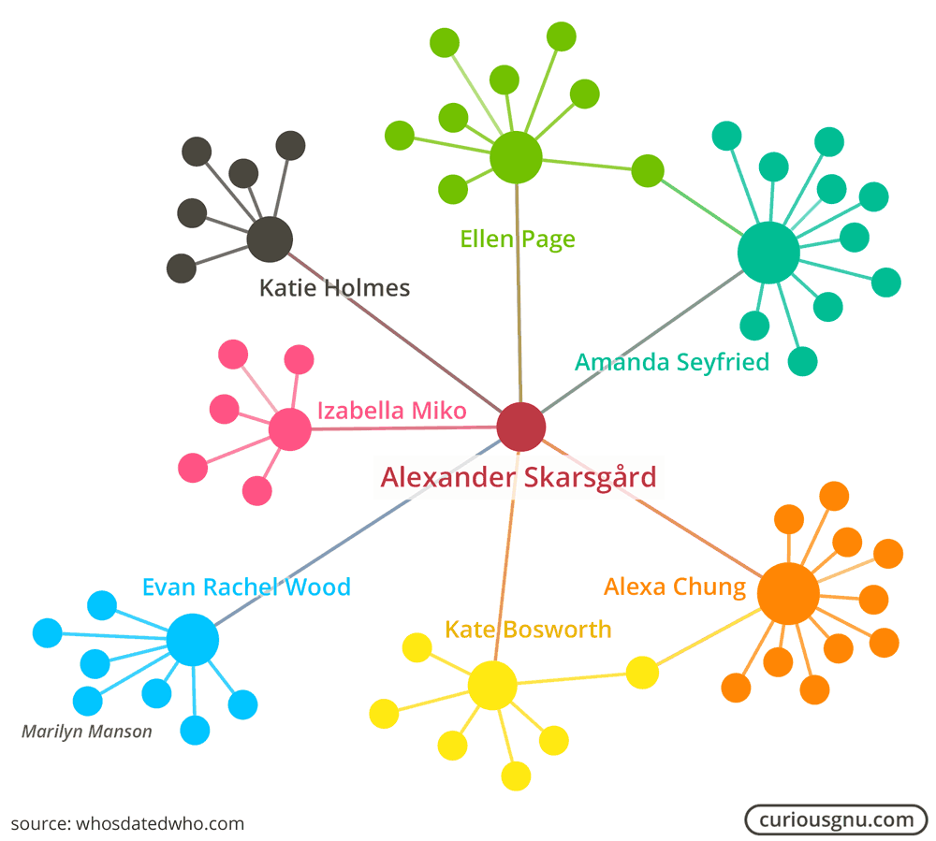
Centrality
What are important vertices?
Need a measure
What characterizes an important vertex?
Centrality
Applications:
Identify the most influential person(s) in a social network
Identify key infrastructure nodes on the Internet or urban networks
Identify super-spreaders of disease
…

Slide 16
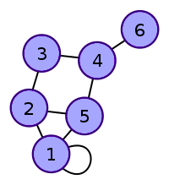
Graph
`
a) Undirected graph
b) Directed graph

Slide 17
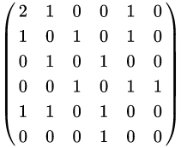
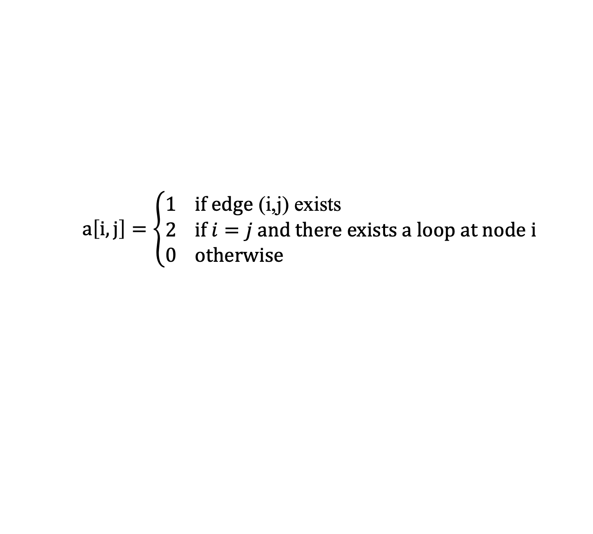
Adjacency matrix
$$a\left[i,j\right]=\left\{\begin{aligned}1 & \text{if} \text{edge}\text{ (}\text{i}\text{,}\text{j}\text{)} \text{exists} \\ 2 & \text{if} i=j \text{and} \text{there} \text{exists} \text{a} \text{loop} \text{at} \text{node} \text{i} \\ 0 & \text{otherwise}\end{aligned}\right.$$
`

Slide 18
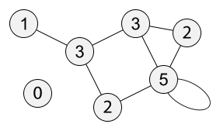
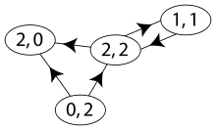
Vertex degree
d_{i}(i) = number of edges to i
d_{o}(i) = number of edges from i

Slide 19
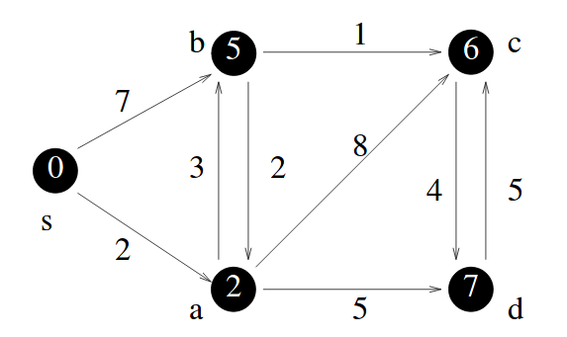
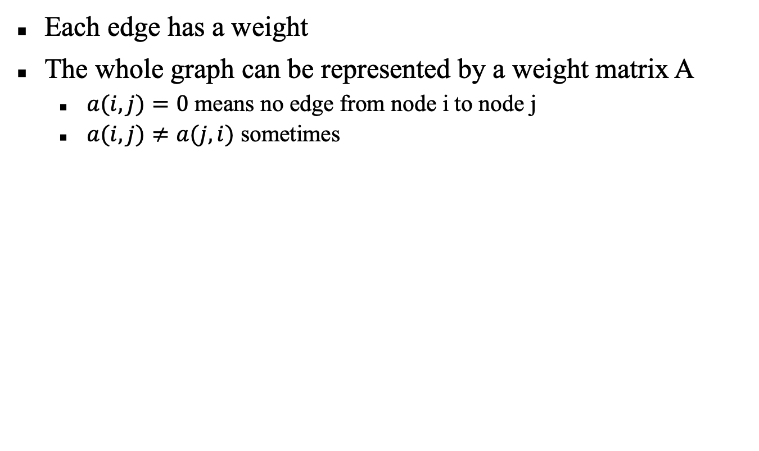
Weighted graph
Each edge has a weight
The whole graph can be represented by a weight matrix A
$a(i,j)=0$ means no edge from node i to node j
$a(i,j)≠a(j,i)$ sometimes

Slide 20
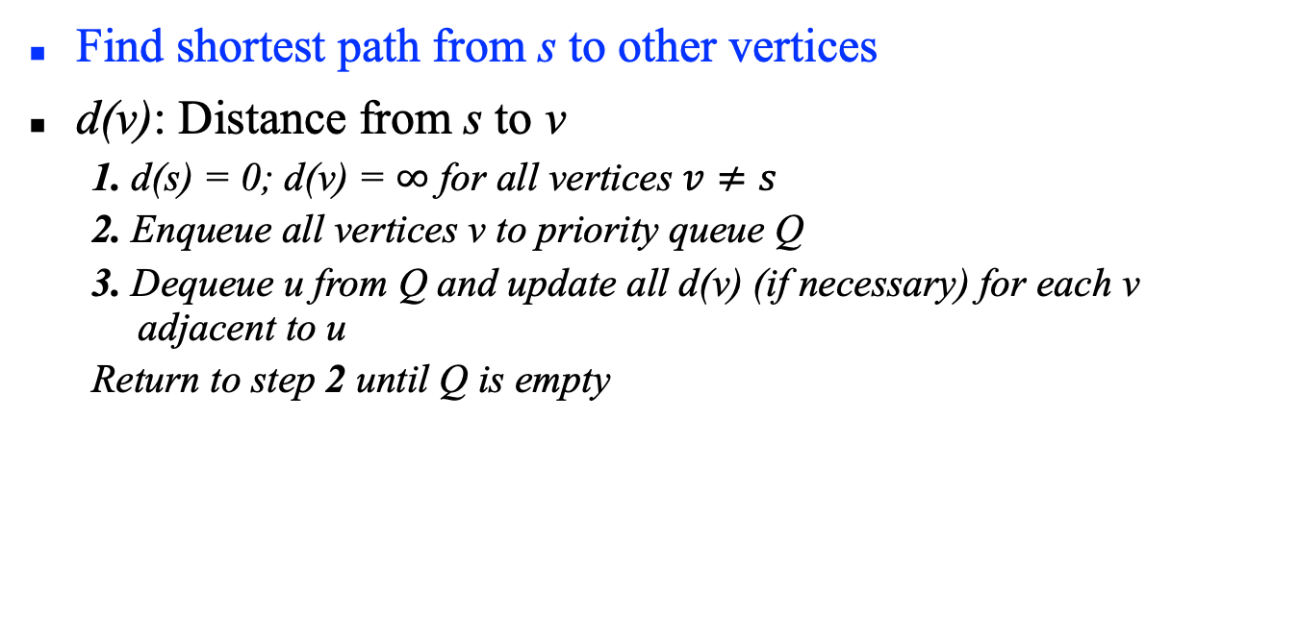
Dijkstra algorithm
Find shortest path from s to other vertices
d(v): Distance from s to v
1. d(s) = 0; d(v) = $∞$ for all vertices $v≠s$
2. Enqueue all vertices v to priority queue Q
3. Dequeue u from Q and update all d(v) (if necessary) for each v adjacent to u
Return to step 2 until Q is empty

Slide 21
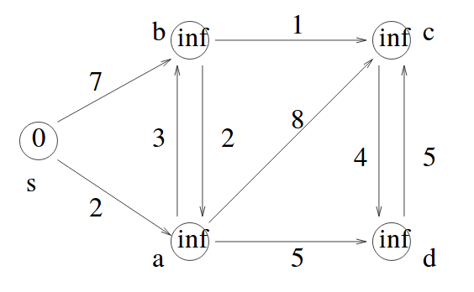
Example

Slide 22
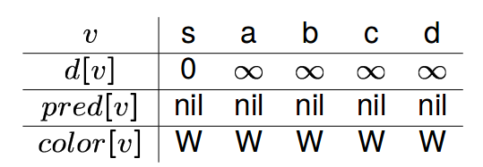
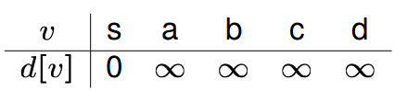
Example (cont)
`

Slide 23
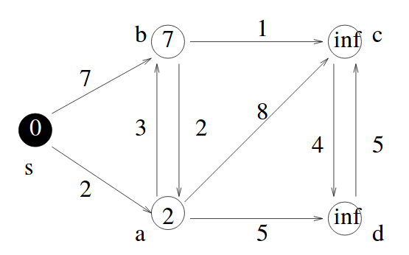
Example (cont)

Slide 24
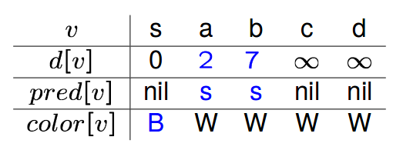
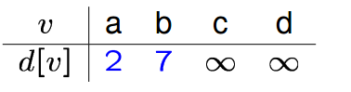
Example (cont)

Slide 25
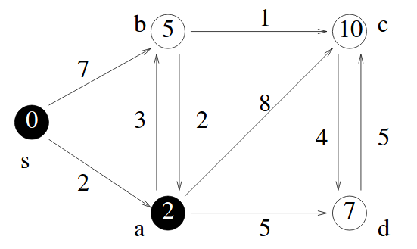
Example (cont)

Slide 26
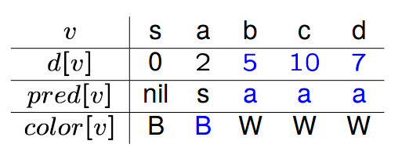
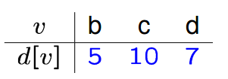
Example (cont)

Slide 27
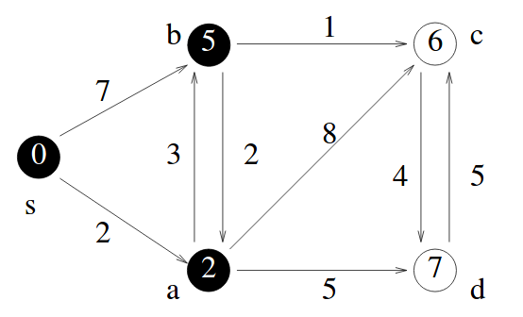
Example (cont)

Slide 28
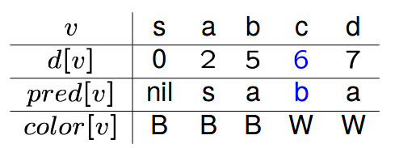
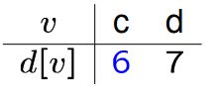
Example (cont)

Slide 29
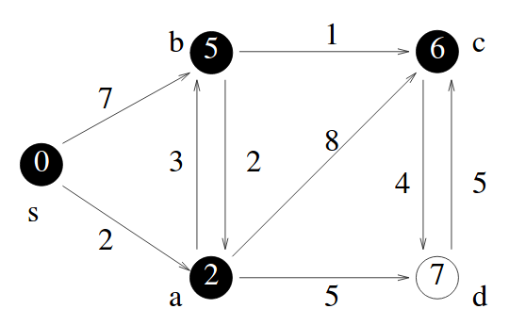
Example (cont)

Slide 30
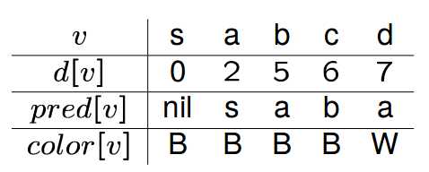
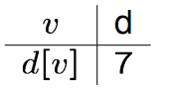
Example (cont)

Slide 31
Example (cont)

Slide 32
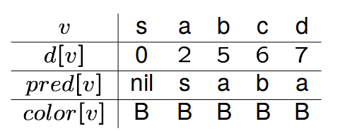
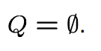
Example (cont)

Slide 33
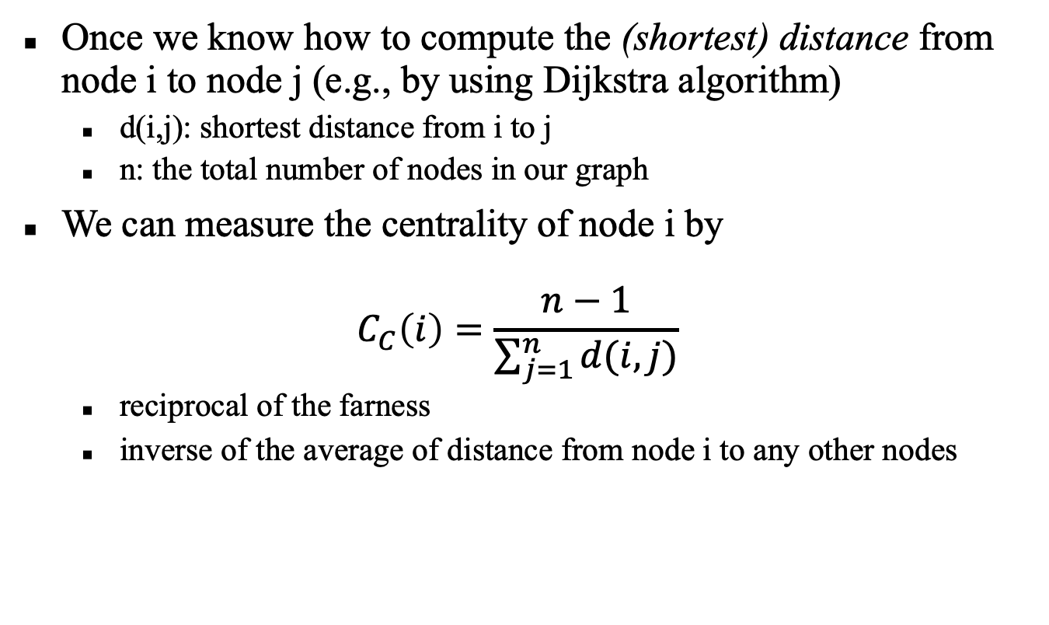
Closeness centrality
Once we know how to compute the (shortest) distance from node i to node j (e.g., by using Dijkstra algorithm)
d(i,j): shortest distance from i to j
n: the total number of nodes in our graph
We can measure the centrality of node i by
$$C_{C}\left(i\right)=\frac{n−1}{\sum_{j=1}^{n}{d(i,j)}}$$
reciprocal of the farness
inverse of the average of distance from node i to any other nodes

Slide 34
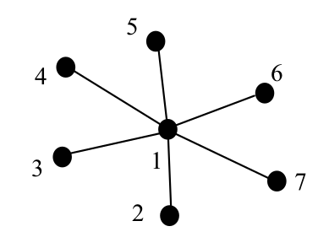
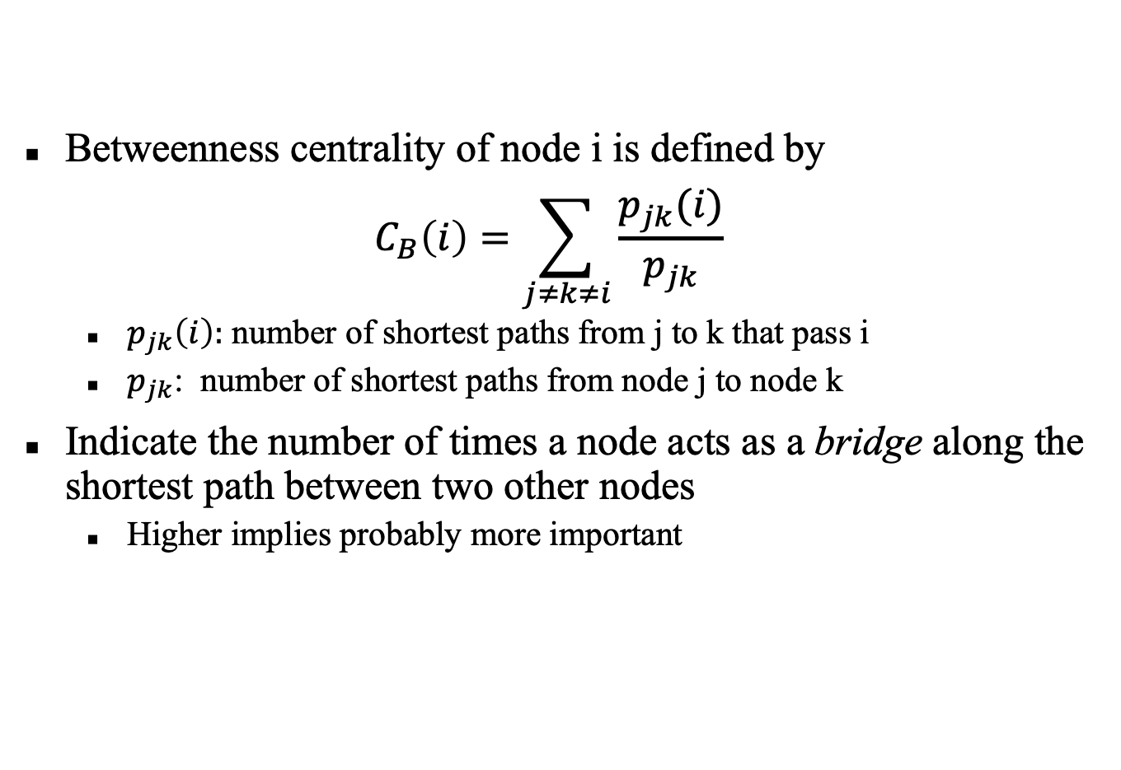
Betweenness centrality
Betweenness centrality of node i is defined by
$$C_{B}\left(i\right)=\sum_{j≠k≠i}{\frac{p_{jk}(i)}{p_{jk}}}$$
$p_{jk}\left(i\right):$ number of shortest paths from j to k that pass i
$p_{jk}$: number of shortest paths from node j to node k
Indicate the number of times a node acts as a bridge along the shortest path between two other nodes
Higher implies probably more important
C_{B}(1) = 15,
C_{B}(2) = C_{B}(3) = C_{B}(4) = 0
C_{B}(5) = C_{B}(6) = C_{B}(7) = 0

Slide 35
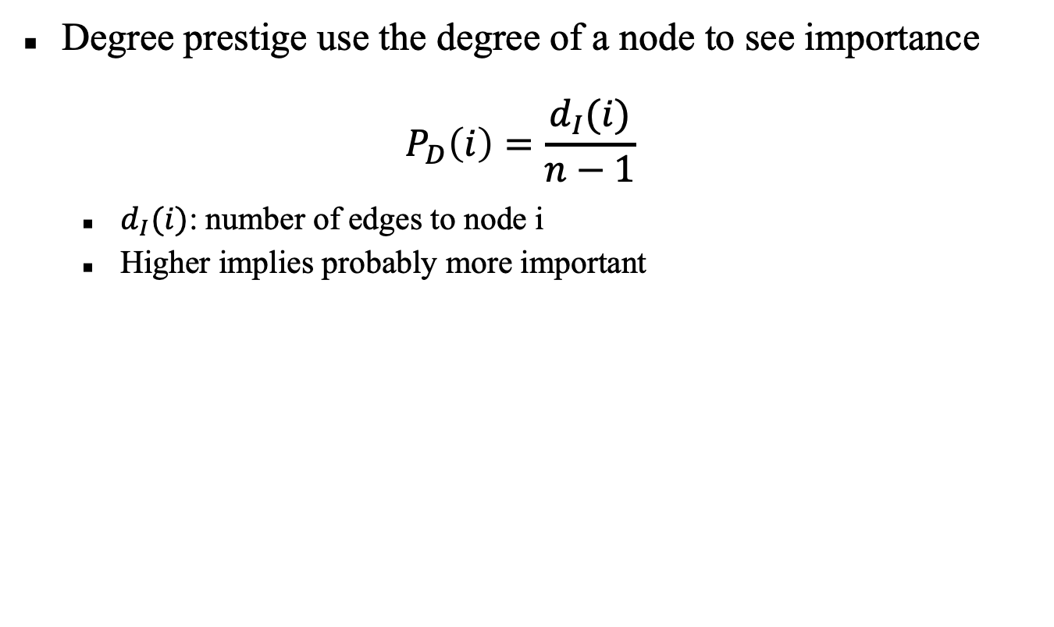
Degree prestige
Degree prestige use the degree of a node to see importance
$$P_{D}\left(i\right)=\frac{d_{I}(i)}{n−1}$$
$d_{I}(i)$: number of edges to node i
Higher implies probably more important

Slide 36
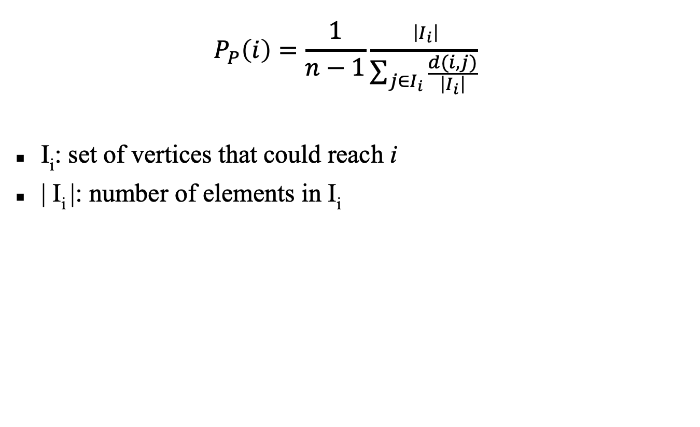
Proximity prestige
$$P_{P}\left(i\right)=\frac{1}{n−1}\frac{ \left|I_{i}\right|}{\sum_{j∈I_{i}}{\frac{d(i,j)}{\left|I_{i}\right|}}}$$
I_{i}: set of vertices that could reach i
| I_{i} |: number of elements in I_{i}

Slide 37
PageRank for ranking

Slide 38
PageRank
Ranking based on the whole structure of the graph
For large graph, ranking is approximated by iterative ‘random walk’

Slide 39
Pagerank scoring
Sec. 21.2
Imagine a user doing a random walk on web pages:
Start at a random page
At each step, go out of the current page along one of the links on that page, equiprobably
“In the long run” each page has a long-term visit rate → use this as the page’s score.
1/3
1/3
1/3

Slide 40
Not quite enough
Sec. 21.2
The web is full of dead-ends.
Random walk can get stuck in dead-ends.
Makes no sense to talk about long-term visit rates.
??

Slide 41
Teleporting
Sec. 21.2
At a dead end, jump to a random web page.
At any non-dead end, with probability 10%, jump to a random web page.
With remaining probability (90%), go out on a random link.
10% - a parameter.

Slide 42
Result of teleporting
Sec. 21.2
Now cannot get stuck locally.
There is a long-term rate at which any page is visited. (not obvious, will show this)
How do we compute this visit rate?

Slide 43
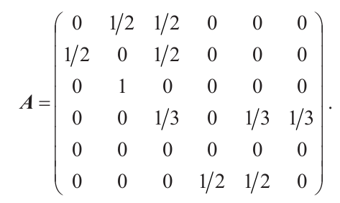
Markov chains
Sec. 21.2.1
A Markov chain consists of n states, plus an n×n transition probability matrix P.
At each step, we are in one of the states.
For 1 ≤ i,j ≤ n, the matrix entry P_{ij} tells us the probability of j being the next state, given we are currently in state i.
i
j
P_{ij}
`
P

Slide 44
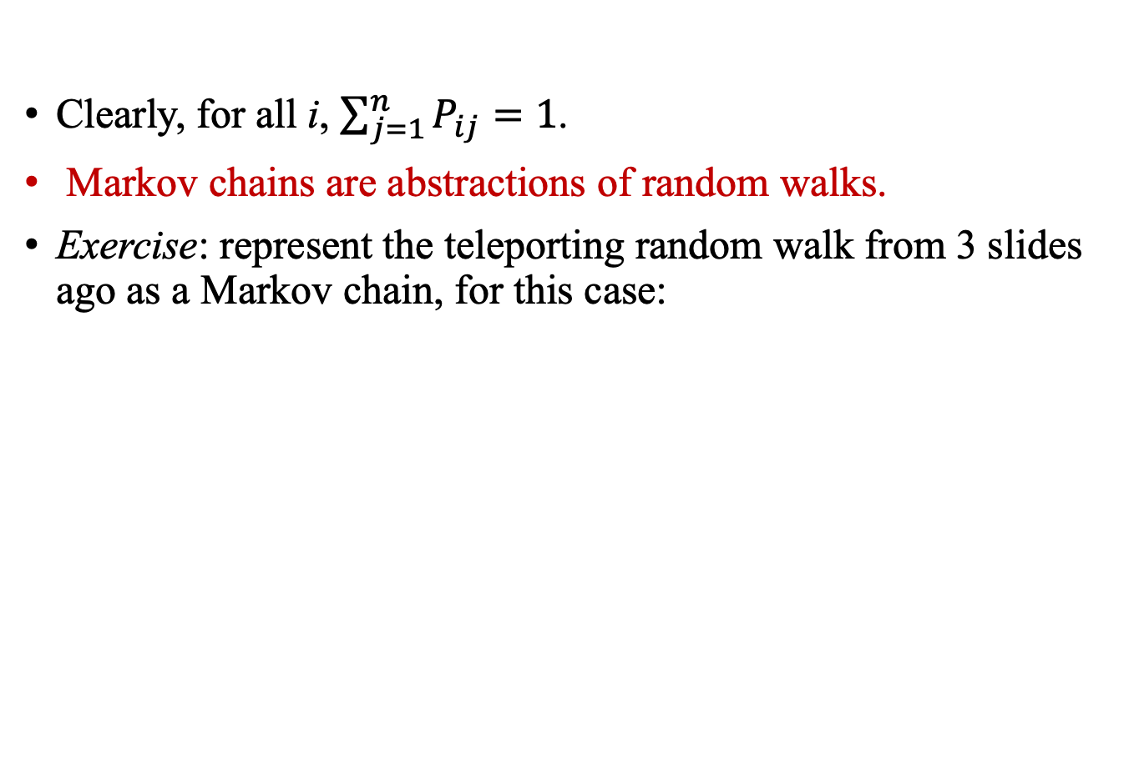
Markov chains
Sec. 21.2.1
Clearly, for all i, $\sum_{j=1}^{n}{P_{ij}}=1$.
Markov chains are abstractions of random walks.
Exercise: represent the teleporting random walk from 3 slides ago as a Markov chain, for this case:

Slide 45
Ergodic Markov chains
Sec. 21.2.1
A Markov chain is called an ergodic or irreducible Markov chain if it is possible to eventually get from every state to every other state with positive probability.
For any ergodic Markov chain, there is a unique long-term visit rate for each state.
Steady-state probability distribution.
Over a long time-period, we visit each state in proportion to this rate.
It does not matter where we start.

Slide 46
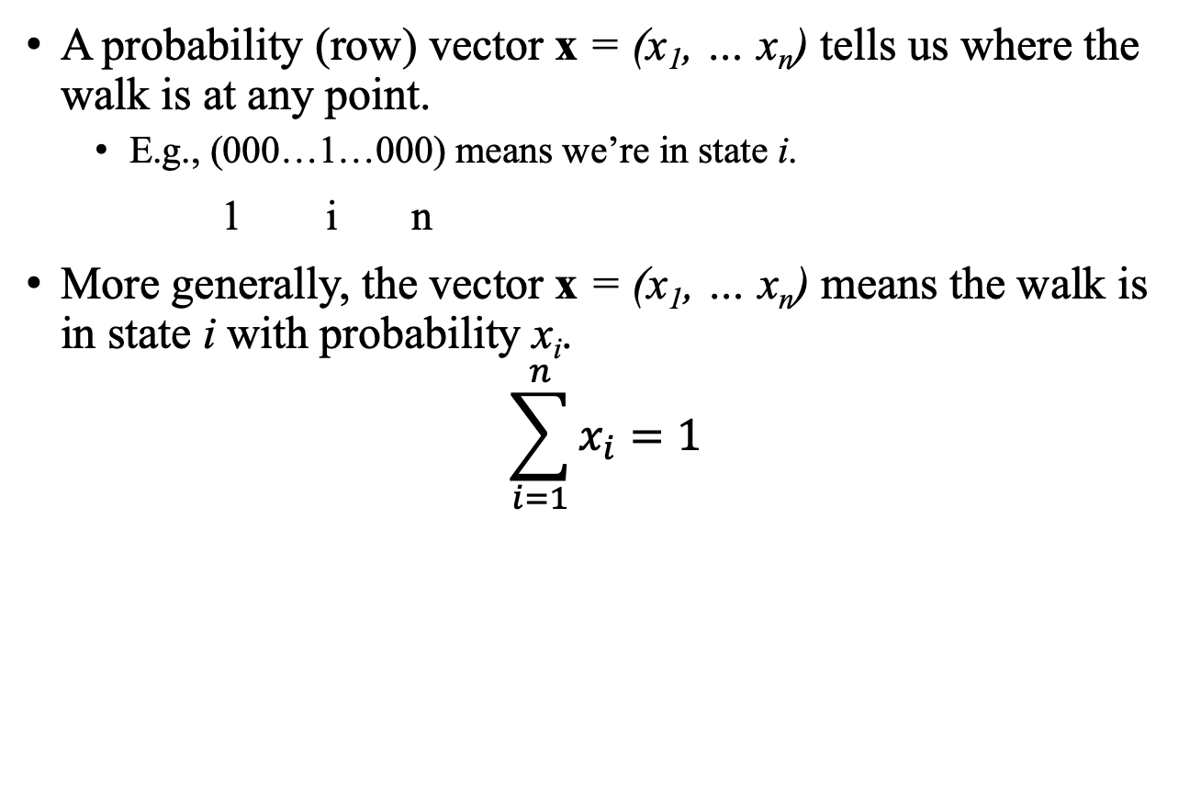
Probability vectors
Sec. 21.2.1
A probability (row) vector x = (x₁, … x_{n}) tells us where the walk is at any point.
E.g., (000…1…000) means we’re in state i.
1 i n
More generally, the vector x = (x₁, … x_{n}) means the walk is in state i with probability x_{i}.
$$\sum_{i=1}^{n}{x_{i}}=1$$

Slide 47
Change in probability vector
Sec. 21.2.1
If the probability vector is x = (x₁, … x_{n}) at this step, what is it at the next step?
Recall that row i of the transition matrix P tells us where we go next from state i.
So from x, our next state is distributed as xP
The one after that is xP², then xP³, etc.
(Where) Does this converge?

Slide 48
How do we compute this vector?
Sec. 21.2.2
Let a = (a₁, … a_{n}) denote the row vector of steady-state probabilities.
If our current position is described by a, then the next step is distributed as aP.
But a is the steady state, so a = aP.
Solving this matrix equation gives us a.
So a is the (left) eigenvector for P.
(Corresponds to the “principal” eigenvector of P with the largest eigenvalue.)
Transition probability matrices always have largest eigenvalue 1.

Slide 49
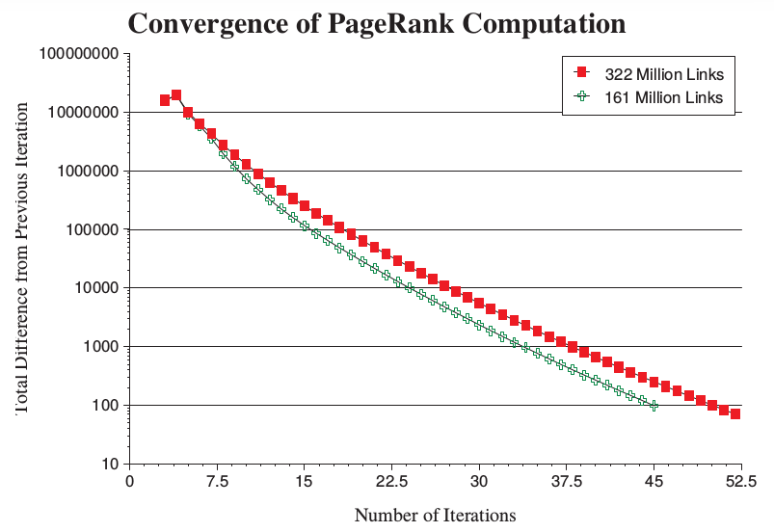
Convergence

Slide 50

Application: Web search

Slide 51
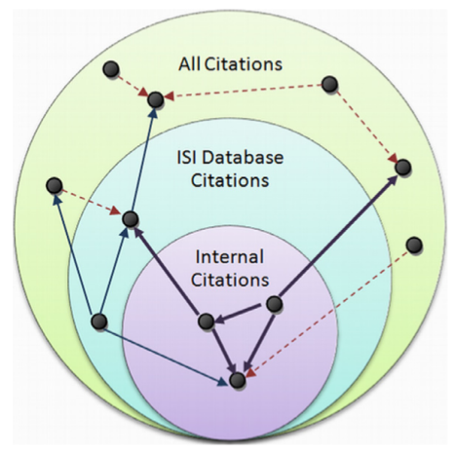
Application: Citation analysis
Guan et al. 2008. “Bringing Page-Rank to the Citation Analysis”

Slide 52
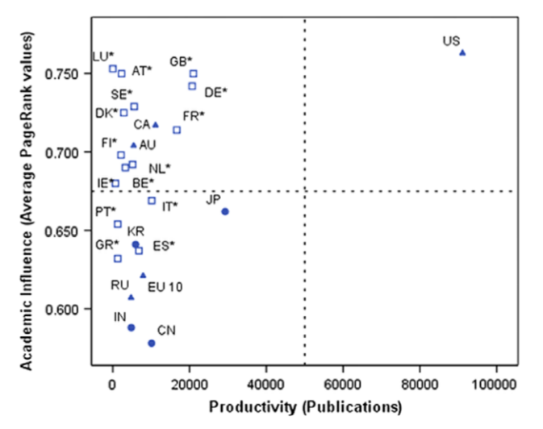
Application: Citation analysis (cont)

Slide 53
HITS for ranking

Slide 54


HITS: Hypertext Induced Topic Search
Kleinberg, Jon M. "Authoritative sources in a hyperlinked environment." Journal of the ACM (JACM) 46, no. 5 (1999): 604-632.
 | Spam filtering | Query relevance | Execution
HIST |  |  | Online
PageRank |  |  | Offline

Slide 55
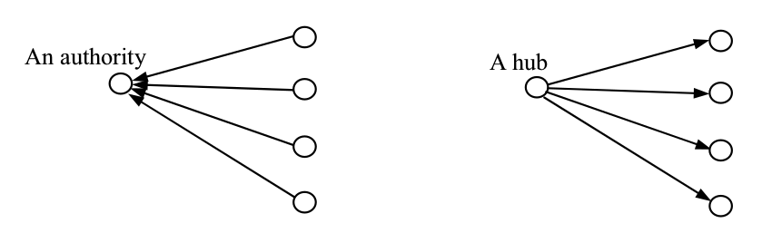
Authority/Hub
Authority: Vertex with a large number of incoming edges
Hub: Vertex with a large number of outgoing edges

Slide 56
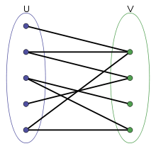
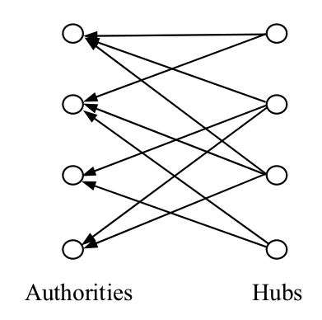
Bigraph
- The vertices is divided into two non-overlapped sets
- Each edge connects two vertices from two sets

Slide 57
HITS algorithm
Input: Query q
Output: Authority and hub score of relevant pages
Algorithm:
1 – Information retrieval
2 – Graph expansion
3 – Ranking

Slide 58
1- Information retrieval
Use a search engine (Google, Bing)
Create root W containing top k relevant pages of q (k = 200)

Slide 59
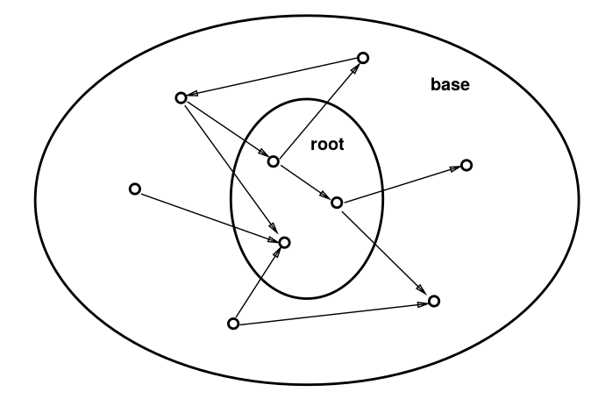
2- Graph expansion
From root W, expand to base S
For each p in W
Add pages to which p links
Add pages that link to p

Slide 60
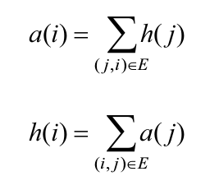
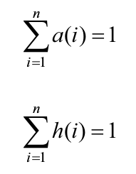
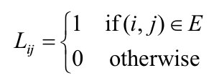
3- Ranking
Authority score (a)
Hub score (h)
G = (V,E)

Slide 61
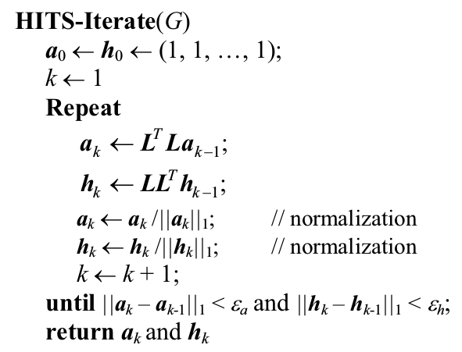
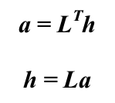
3- Ranking (cont)
`

Slide 62

Thank you for​ your attentions!​

